Slide 1











OOPs:
(Object Oreinted Programming Style)
Presented by :-
Manish
Udit
khushi
Dhwani
Riya

Slide 2



What is OOPs?
OOPs is Style of Programming.
OOPs means designing your code using real-world objects which have properties (data) and methods (actions).

Slide 3
Function-oriented languages cannot bind data and actions together.
01.
Why OOP is Needed?
In OOPs data will be secure not Global.
02.
In OOPs each object/class is independent.
03.

Slide 4

Function Oriented
Object Oriented
Program is made using function .
Program is made using Object and classes .
Focus on logic and functions.
Difference between Function Oriented and Object Oriented
Focus on data (object) and behaviour(method).
Ex :- Java , C++ , python
Ex :- C language

Slide 5
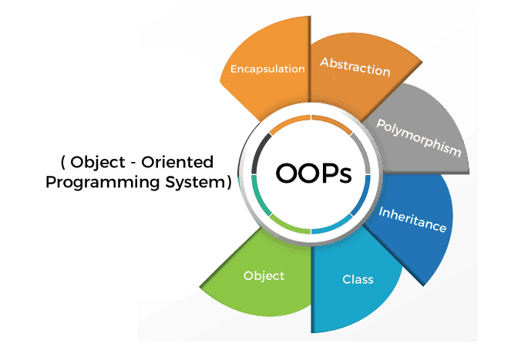
How OOPs ?
Concept of OOPs :-
Object
Class
Encapsulation
Abstraction
Polymorphism
Inheritance

Slide 6

1 - Object
Object is a real world entity.
Object belongs to the class/factory.
Object may have certain n number of properties or may have certain n number of behaviours.
Example :- Pen , AC , Fan , etc.
(Color and Size are the properties and what they work is called behaviour.)

Slide 7
2 - Class
Class is a User define type.
Once we define a class then we can create n number of objects.
Class is the collection of similar type of object.
Example :-
Class | Properties | Method
Car | Brands , color | Start , stop
Person | Name , Age | talk , walk

Slide 8

3 - Encapsulation
Wrapping of data and functions into one unit.
Helps in data hiding and security.
Example:
Capsule :-
Medicine = data
How it works = function

Slide 9

4 - Abstraction
Hiding unnecessary information from the user and showing only essential things.
(Showing only important features, hiding background details)
Example :
Using a TV remote —
we press buttons without knowing the circuit.

Slide 10


5 - Polymorphism
One thing has different implementations called polymorphism.
One name, many forms
Example :
A person acts as —
Son
Son at home
Student in school
Employee at work
Student
Employee

Slide 11

6 - Inheritance
When object of one class acquires the properties of another class.
By using existing thing to develop something new but this should not be changes in existing thing.
Example :
Father and Son —
Son inherit surname , habit or features from father

Slide 12
Conclusion
Object-Oriented Programming (OOP) models real-world entities using classes and objects, making code more organized, reusable, and secure. With key concepts like encapsulation, inheritance, abstraction, and polymorphism, OOP simplifies complex problems and makes programs easier to build and maintain.
Thank you!

